Slide 1
Welcome to CDC South Africa!
Jonathan Grund, QI Branch Chief

Slide 2
My experiences in SA

Slide 3
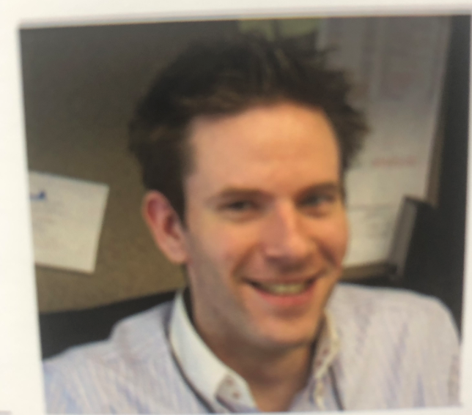
Me in 2009, HIV Prevention Branch

Slide 4
The Basics

Slide 5
Department of Health
Mandate = National Health Act 2003
Healthcare a basic human right (Bill of Rights, Section 27)
Supported National Development Plan, Medium Term Strategic Framework
Ensuring a long healthy life for all South Africans
Responsibilities at 3 levels of government
National, Provincial & District

Slide 6
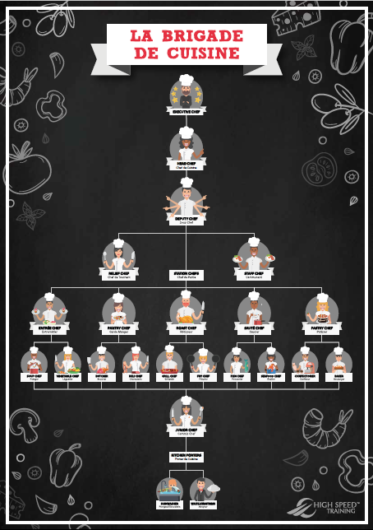
PEPFAR/CDC
NDoH = Executive Chef; CDC = Sous Chef (Deputy Chef)
Invited at discretion of Head Chef (i.e. Relationship building is key)
One of many players in the kitchen
DSPs = Chef de Tournant/Swing Cook/Relief Cook (fills in as and when is needed)

Slide 7
Clinic
Facility Manager = Head Chef
CDC = Sous Chef
DSP = Chef de Tournant/Swing Cook/Relief Cook (fills in as and when is needed)
Chain – branding/support materials etc. and permission to implement large scale change comes from franchisee
Franchisee = District

Slide 8
11 official languages = many cultural differences
At least thirty-five languages indigenous to South Africa, 11 of which are official languages of South Africa
Geography = specific cultural nuances
Let DSP/NDoH/District take the lead
Friendly & respectful at all times
Follow protocol; Always greet Facility Manager before rounds (if not available, be sure to greet before leaving)
Engage with personnel (ALL) on a personal level/ make a connection before diving into work (Hi, How are you = culturally obligatory)

Slide 9
SA English is not US English
Yes = I heard you NOT I will do it.
https://www.youtube.com/watch?v=VeeSCCrK_T8
https://www.youtube.com/watch?v=7LitAEbw-Co
https://www.brandsouthafrica.com/people-culture/culture/south-african-english

Slide 10
DSP = Tour Guide
Check with DSP which are terms of respect in your geography and how to use them
Check with DSP (and heed their guidance) on protocol in meetings/engagements

Slide 11
Understand the Framework
Constitution and legislative Framework = one of the most robust in the world
Are you aware of all existing National, Provincial or District policies and guidelines?
Don’t assume that there is or is not a policy.
Find out what policies exist and what the policy gaps are.
If there are multiple policies, which is used on site and why?
New proposals should be socialized/introduced by the CDC South Africa office (so suggest up).

Slide 12
Requests
Ensure that there are no unauthorized obligations.
If there are any requests that require procurements or funding changes the Project Officer should always be informed/consulted.
District health service, PHC, and HAST program

Slide 13
Thank you! Enkosi! Ngiyabonga!

